Slide 1
HARDWARE AWAREMESS
When you talking about SQL Server performance tuning, ultimately you’re asking, ‘how can we take advantage of the hardware on the server and/or improve the hardware so that the SQL Server runs more efficiently?’ That is not to say that we should just go out and buy faster servers to resolve the issues of performance; actually that is the last thing we should do.
But an understanding of what the basic main physical hardware of a server does helps us greatly tuning the SQL server. The four main devices we should be aware of are as follows:
  Disks - the repository of the data
  CPU (central processing unit) - the ‘brains of the server’
  Memory - the main holder of ‘temporary data’
  Network – the communication between the network and the servers

Slide 2
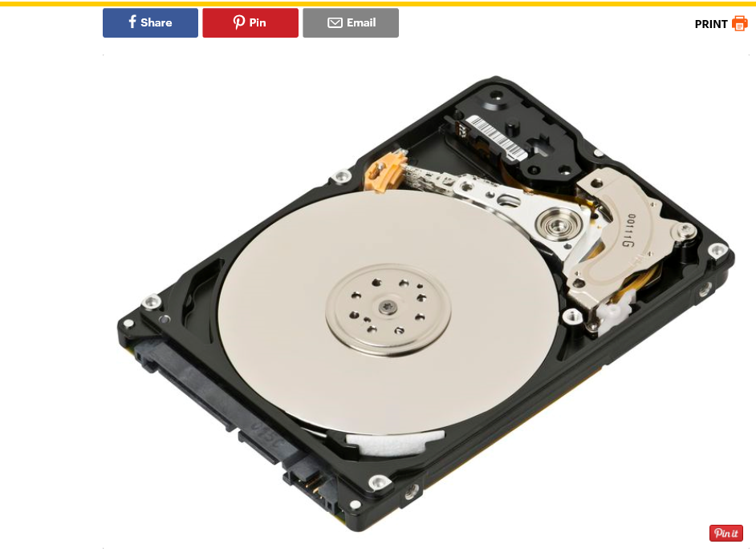
Hard drive disk
The device that controls the positioning, reading and writing of the hard disk and stores data. The arm slides back and forth for data retrieval. One of the more important device to tuning and monitor

Slide 3
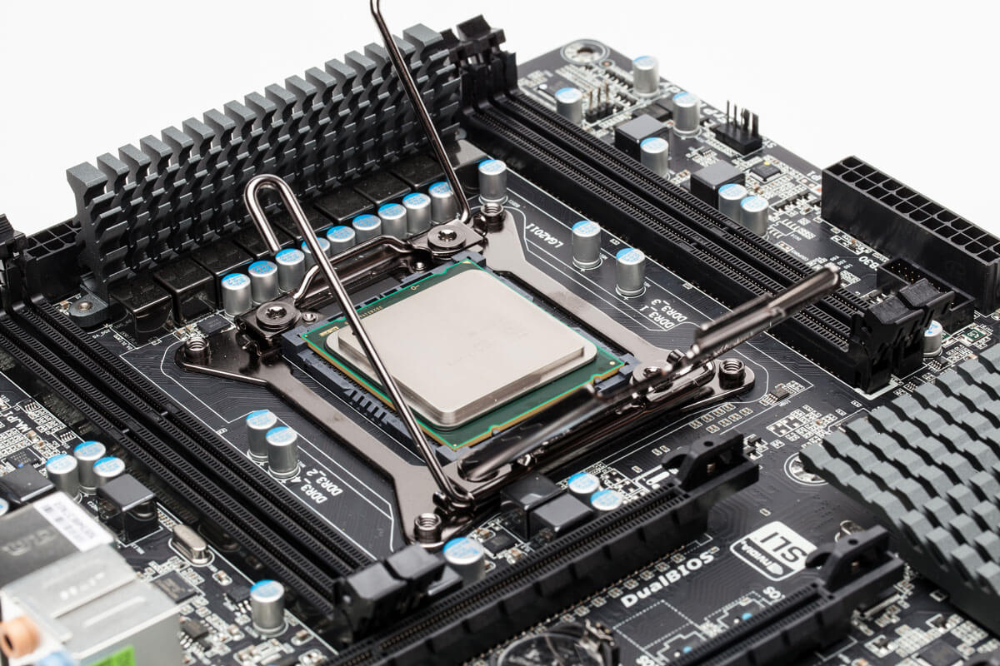
The CPU (Central Processing Unit
The CPU (Central Processing Unit) is the part of a computer system that is commonly referred to as the "brains" of a computer. The CPU is also known as the processor or microprocessor. The CPU is responsible for executing a sequence of stored instructions called a program.

Slide 4
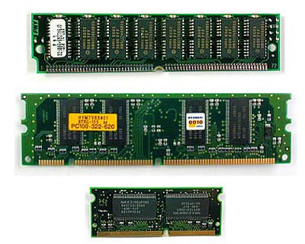
Memory
Computer memory is any physical device capable of storing information temporarily or permanently. For example, Random Access Memory (RAM), is a volatile memory that stores information on an integrated circuit used by the operating system and software

Slide 5
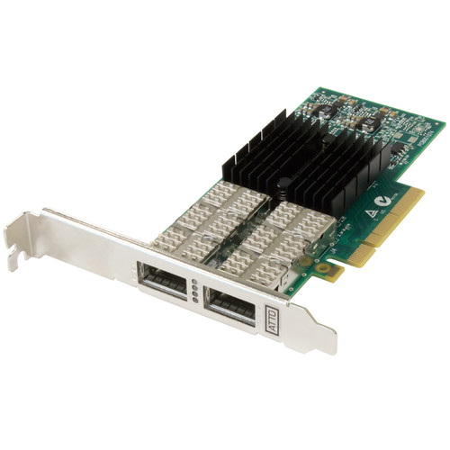
Network Interface Card
Short for Network Interface Card, the NIC is also referred to as an Ethernet card and network adapter. It is an expansion card that enables a computer to connect to a network; such as a home network

